Slide 1
Macros

Slide 2

Camera Expectations

Slide 3

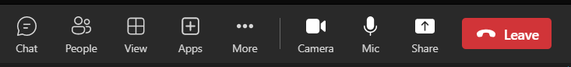

Before we start… Please have your camera switched on.
Camera Expectations
This is a mandatory requirement for the duration of the course.
You are studying a regulated qualification, your tutor needs to see that it is the right person participating throughout the course.
Our job is to prepare you for work in an age where in almost any job there is likely to be at least some aspect of remote engagement with your employer.
Online learning is to be treated the same way as a classroom learning, you must be physically visible to interact with your tutor and other learners in order to create an engaging group dynamic.

Slide 4
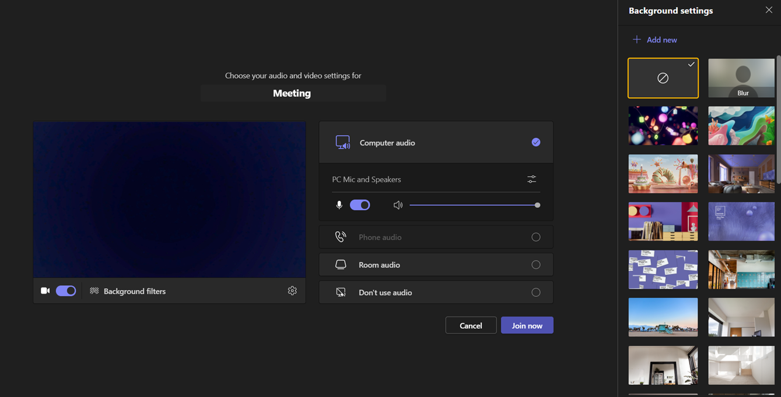
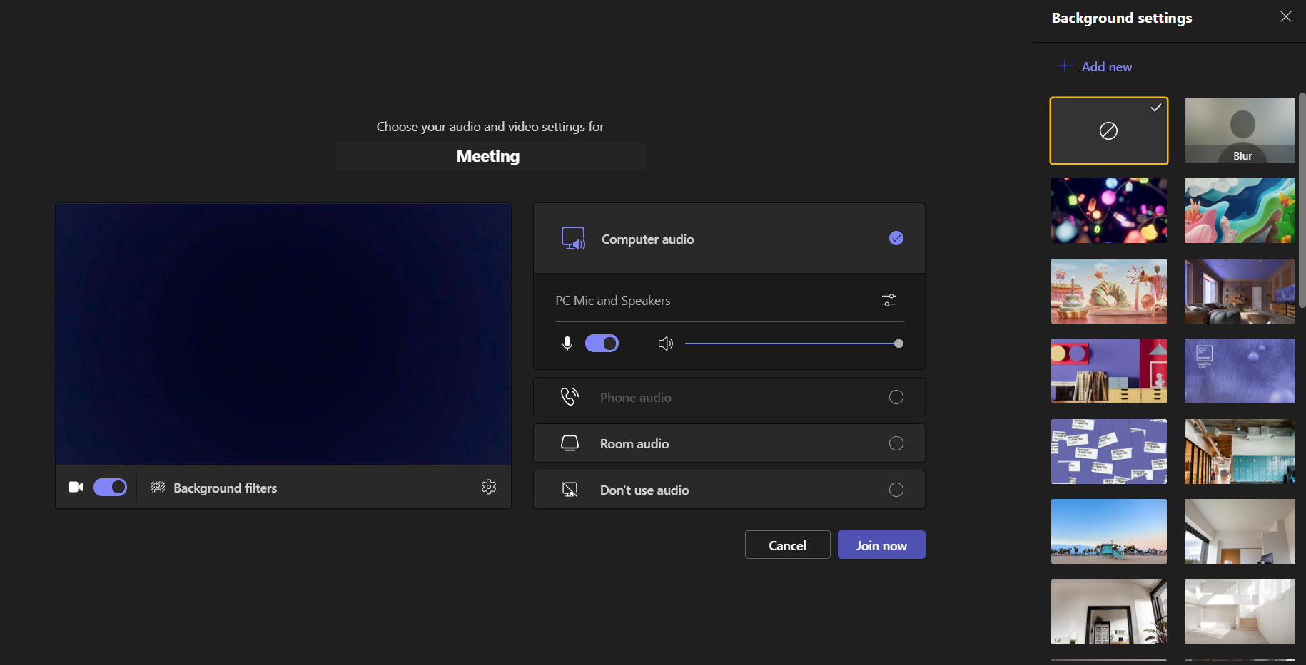
Background filters
If you do not wish to have your camera displaying your personal environment, Microsoft Teams has a solution to this problem…
Step One: Before you join a Teams video call, click the ‘Background Filters’ option.
Step Two: On the right-hand side, you can select any of the stock images.
Step Three: The image you choose will then appear in your background on the video call.
If you need any further support in regards to this requirement, please speak to your tutor directly.

Slide 5
Macros
Macros record keystrokes and mouse-clicks
Use shapes to run macros

Slide 6
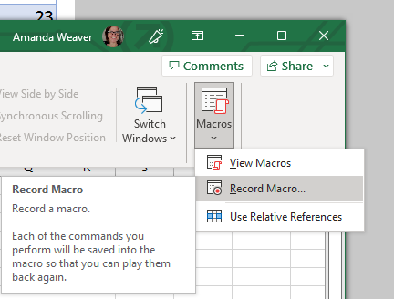
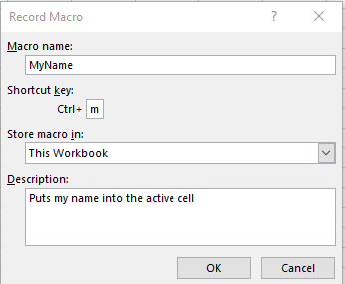
Macros record keystrokes and mouse-clicks
Open a new blank workbook.
Begin recording a macro called MyName with a shortcut key of <Ctrl>+<m>.
1. Click: View→Macros→Macros→Record Macro.
2. Type MyName into the Macro name box.
Note that macro names cannot contain spaces.
3. Type a lower case ‘m’ into the Ctrl+ box.
4. Select This Workbook from the Store macro
in drop-down list.
5.Describe your macro in the Description box
6. Click the OK button – but do nothing else!
Notes:
VBA is a Programming language that can be used to write custom extensions to Excel
Macros are a very misunderstood concept. Most books cause terrible confusion by mixing up the twin subjects of macros and the VBA (Visual Basic for Applications) programming language. You don’t need to know anything about the VBA programming language to use macros.
Note:
You are now recording your macro. There’s no time element to a macro recording, so you can be relaxed. The macro will record every key press and every mouse click, so it is important that you do not press any keys or click anywhere with the mouse.

Slide 7
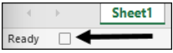
Record a macro that will put your name into the active cell.
1. Type your name into the currently active cell.
2. Press <Ctrl>+<Enter>.
When you press <Ctrl>+<Enter> you save the value into the cell without moving to the next line. This keystroke combination is very useful when recording macros.
4. Stop the macro recording.
You can do this in two ways:
Click: View→Macros→Macros→Stop Recording.
OR
Click the Stop button at the bottom left of the screen.
Notes:
Remember that every click and keystroke are recorded, so be careful not to move to any other cell. If you did, your name would always appear in the cell you had moved to when the macro was played.

Slide 8
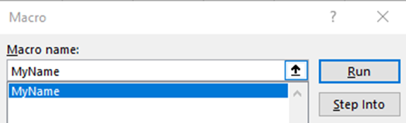
Test the macro.
1. Click in any blank cell.
2. Click: View→Macros→Macros→View Macros.
The Macro dialog appears, listing only the MyName macro (as
you have only recorded one macro so far).
3. Click the Run button.
Your name appears in the currently active cell.
4. Click in another blank cell and press: <Ctrl>+<m>
Once again your name appears in the currently active cell.
6 Close the workbook without saving.

Slide 9
Use shapes to run macros

Slide 10
Use shapes to run macros
1 Open Mortgage Calculator-10 from your sample files folder.
2 Record a macro in This Workbook called PrintWorkbook.
Click: View→Macros→Macros→Record Macro.
Type PrintWorkbook in the Macro name box.
Describe what the macro does in the Description box (Print the Workbook).
4. Click the OK button.
5. Click: File→Print→Print.
The worksheet will print out on your default printer.
6. Click: View→Macros→Macros→Stop Recording

Slide 11
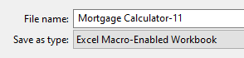
1. Click: File→Save As→This PC→Browse.
2. Navigate to the folder that you wish to save the file in.
3. Select Excel Macro-Enabled Workbook from the Save as type dropdown list.
4. Type: Mortgage Calculator-11 in the File Name box.
5. Click the Save button

Slide 12
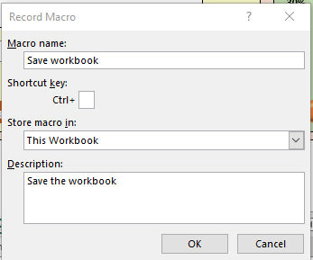
Record a macro in This Workbook called SaveWorkbook.
1. Click: View→Macros→Macros→Record Macro.
2. Type SaveWorkbook in the Macro name box.
3. Describe what the macro does in the Description box (see sidebar).
4. Click the OK button.
5. Click: File→Save.
6. Click: View→Macros→Macros→Stop Recording.

Slide 13
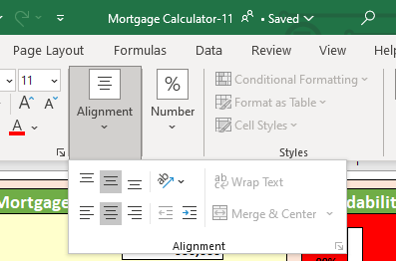
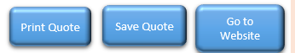
7. Right-click on the button and click Edit Text from the shortcut menu.
8. Type: Save Quote to add a caption to the shape.
9. Click: Home→Alignment→Middle Align.
10. Click: Home→Alignment→Center.
11. Copy and paste the shape twice.
12. Change the captions on the other two shapes to read Print Quote and Go To Website. You may need to resize the button to get the text to fit.

Slide 14
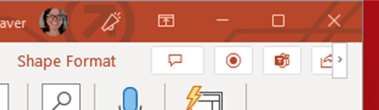
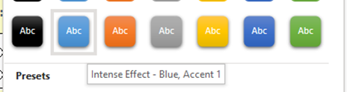

Add three shape controls to the worksheet.
1. If the worksheet is protected:
Click: Review→Protect→Unprotect Sheet.
2. Re-size the pie chart to make space for a row of buttons underneath.
3. Click: Insert→Illustrations→Shapes→Rectangles→Rectangle: Rounded Corners.
4. Click and drag on the worksheet to draw the button.
5. Click: Shape Format→Shape Styles→More→Intense Effect – Blue, Accent 1

Slide 15
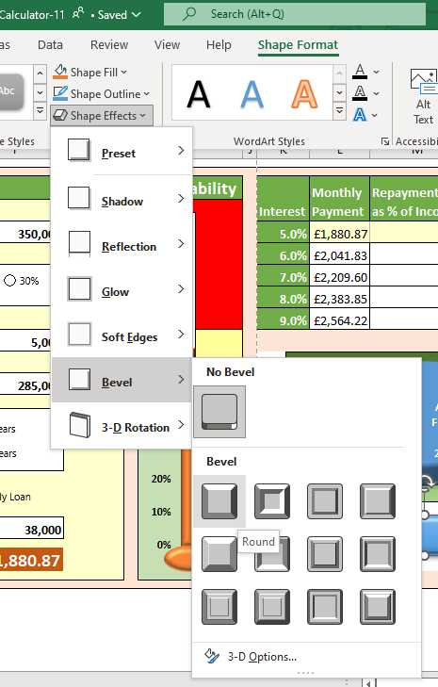
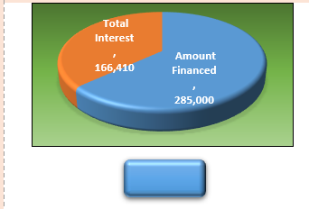
6. Click: Shape Format→Shape Styles→Shape Effects→Bevel→Round.

Slide 16
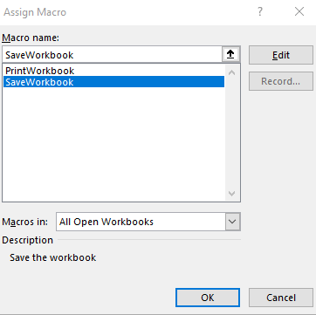
Connect the Save Quote and Print Quote shapes to the SaveWorkbook and PrintWorkbook macros.
1. Right-click the Save Quote shape.
2. Click Assign Macro… from the shortcut menu.
3. Select the SaveWorkbook macro.
4. Click the OK button.
5. Follow the same procedure to assign the PrintWorkbook macro to the Print Quote shape.

